Slide 1
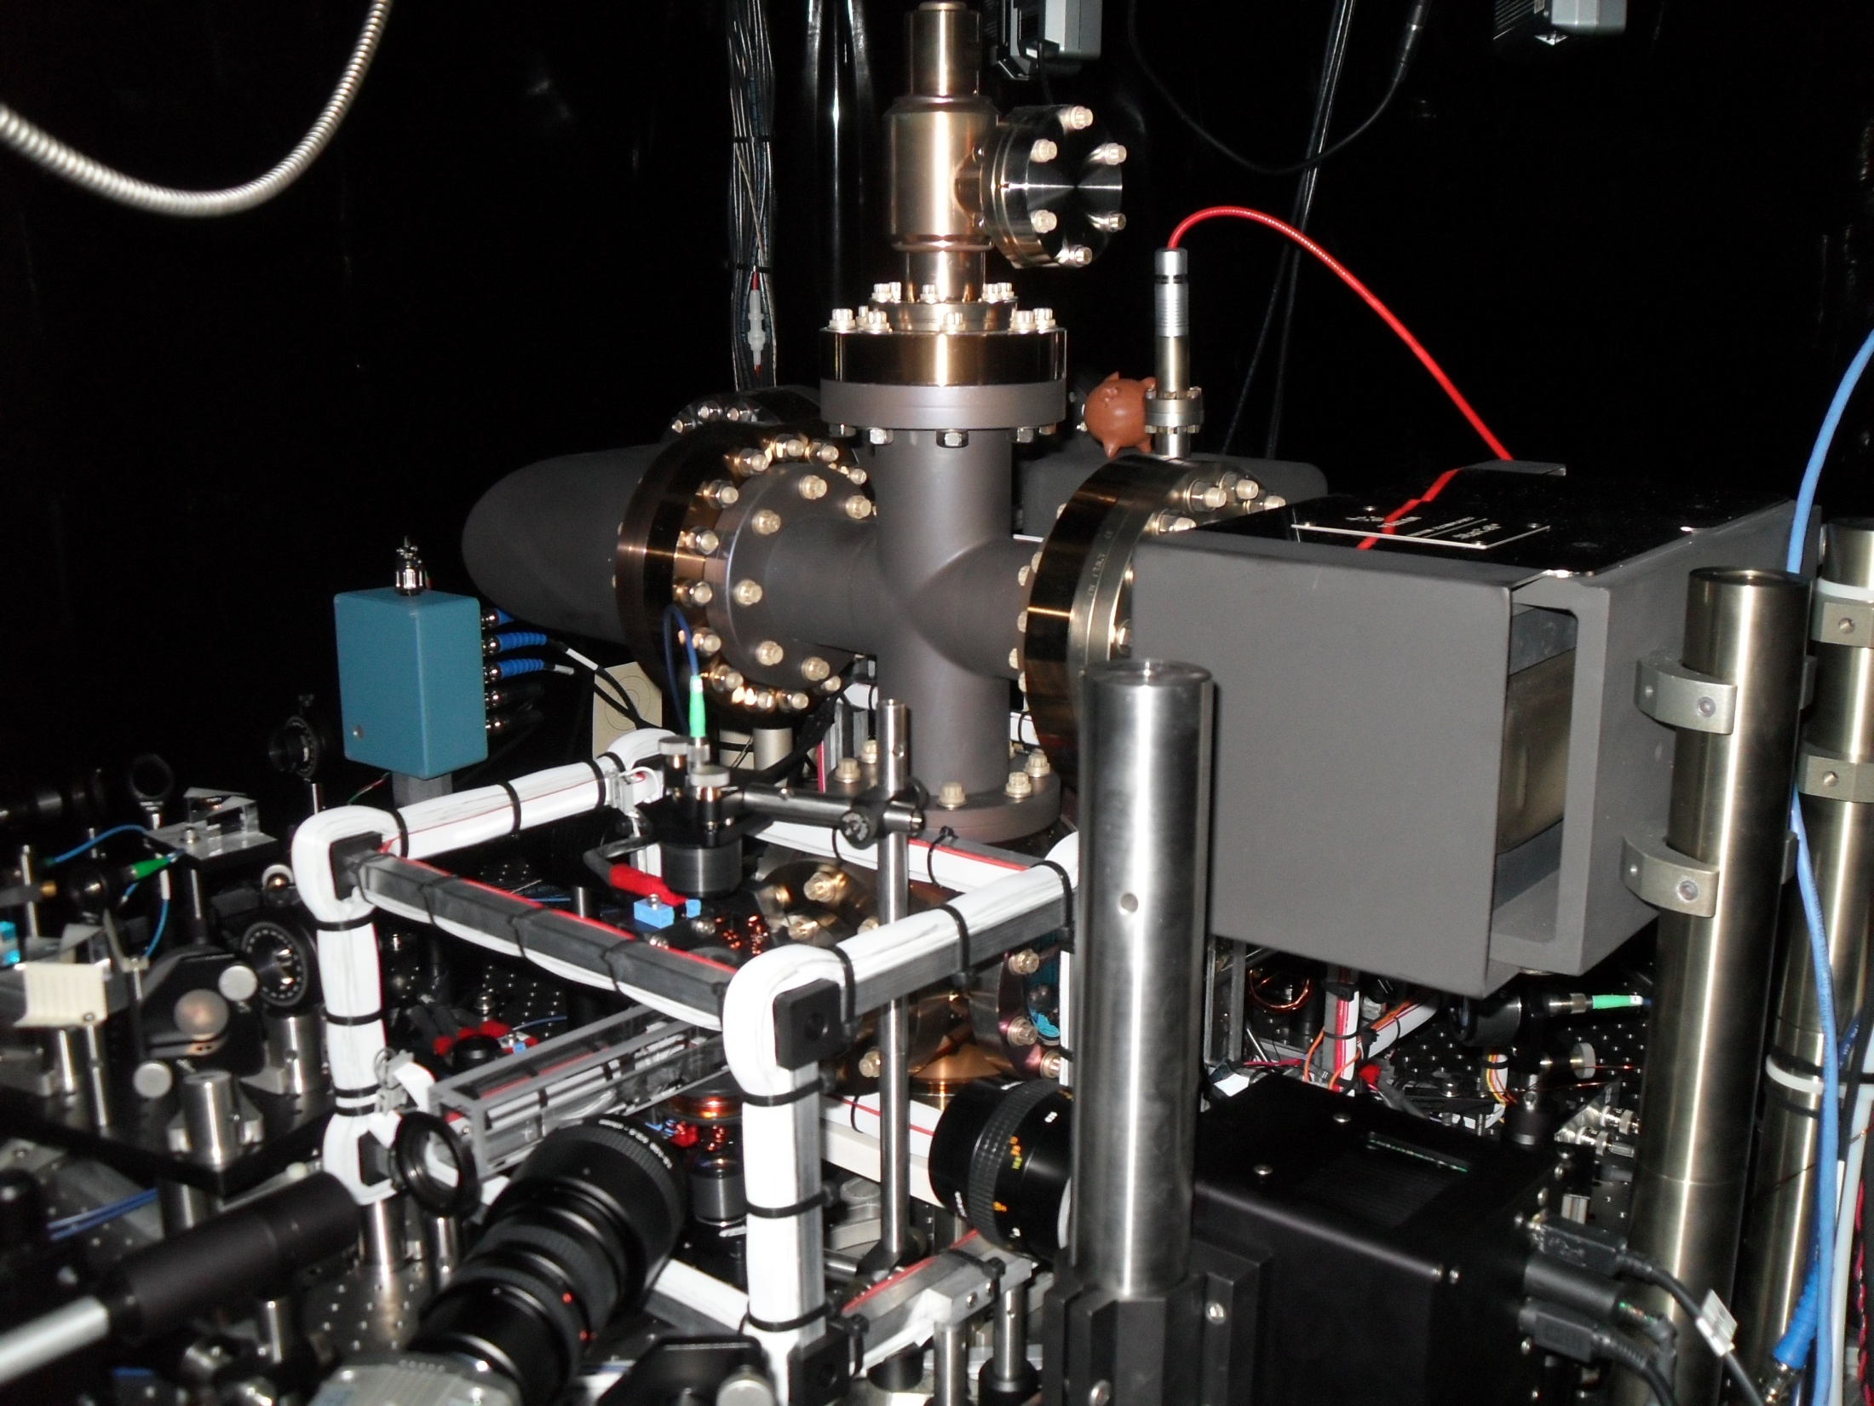
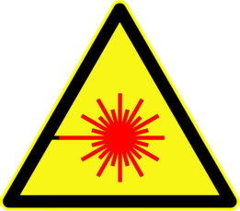
Atom Optics
Measurement of the
Casimir-Polder Force
Principle Investigator
Daniel A. Steck
Tobias L. Brown-Heft
UCORE 2010

Slide 2
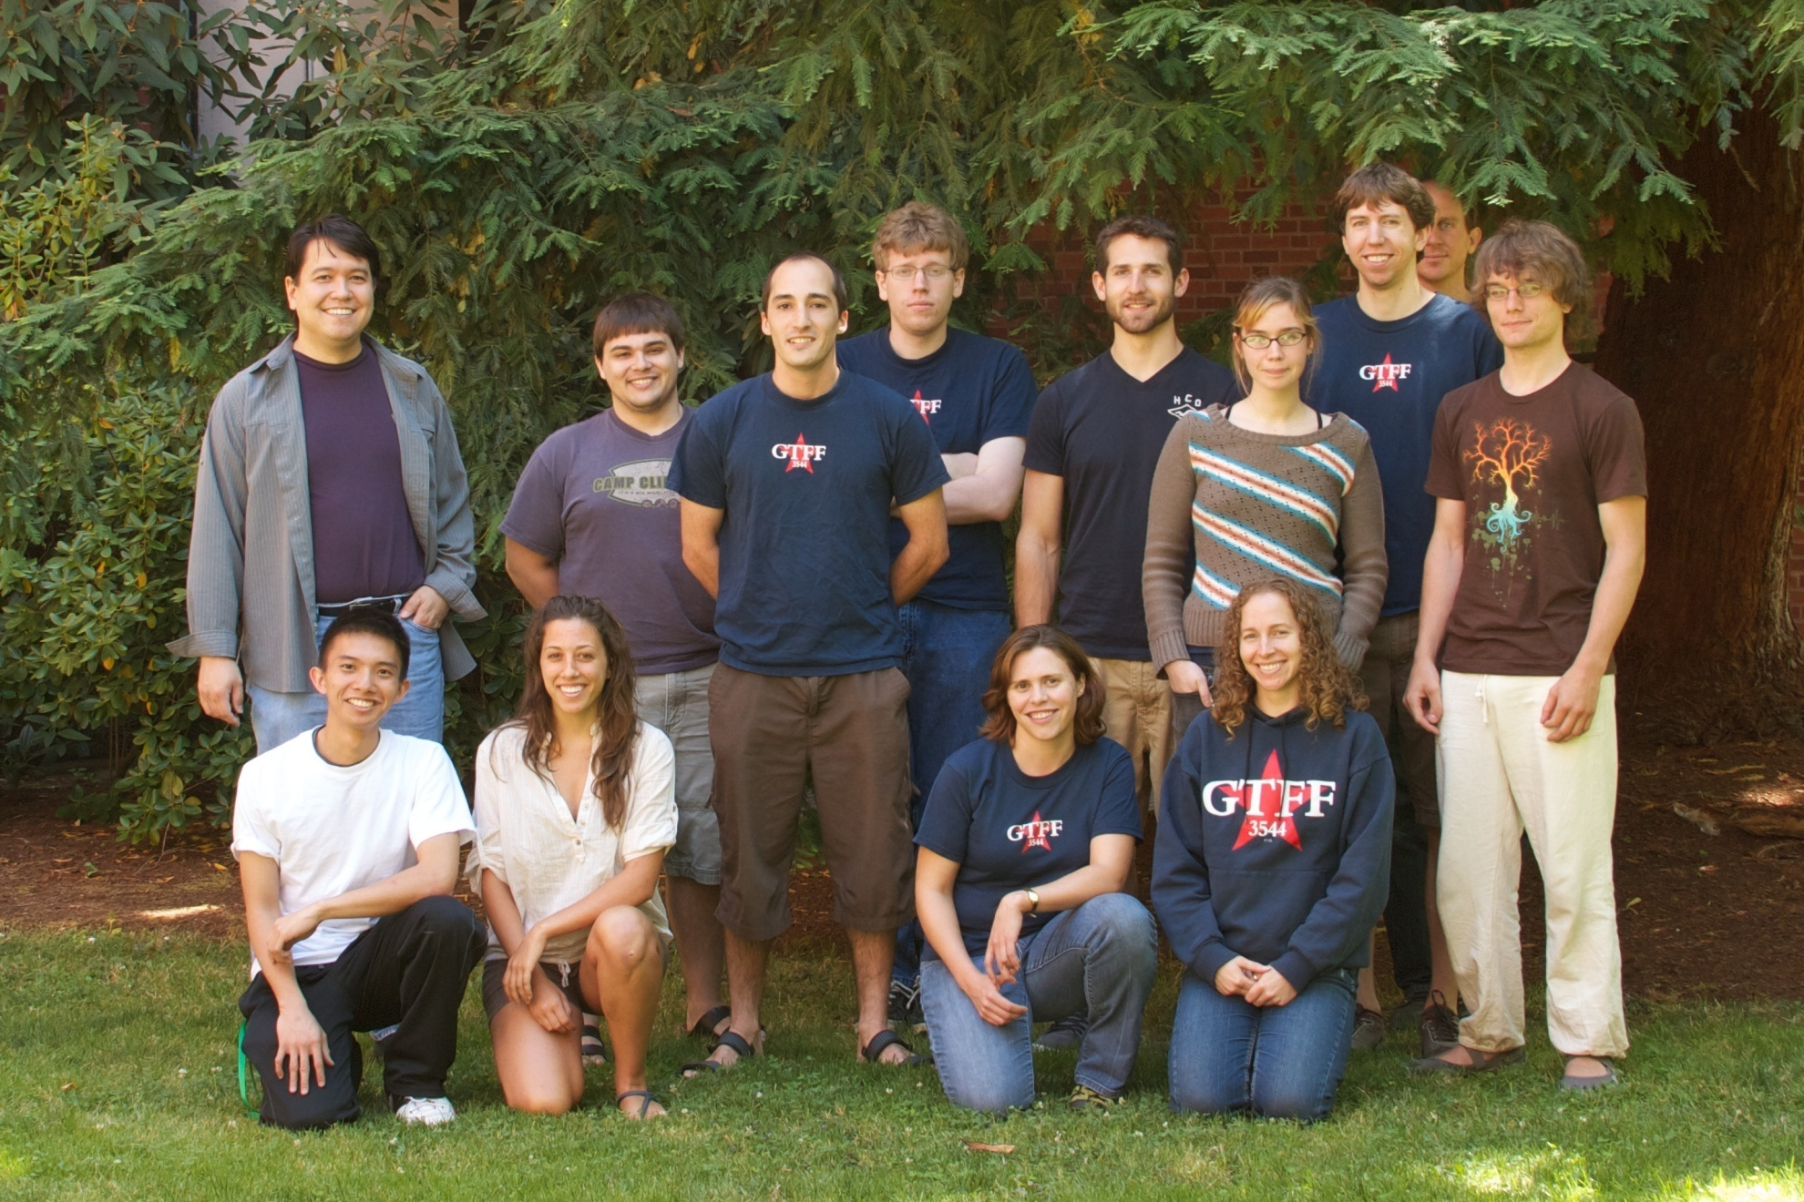
Steck Lab

Slide 3
Presentation Outline
Big Picture
  Science is good.
  Distant future applications.
Lab Focus
  Develop experimentation for Strontium atoms.
  Measure the Casimir-Polder Force.
  Diode Lasers
UCORE Fellow Contribution
  Master Laser Driver
  Fabry-Perot Cavity
More Detail on Future Applications, Time Allowing

Slide 4
General Goals of Steck Lab
Gain a deeper understanding of quantum mechanics.
  It’s the future!
  Fundamental Research.
Practical applications of the research.
  Distant future.
  Gecko Toes.
  Wormholes.

Slide 5
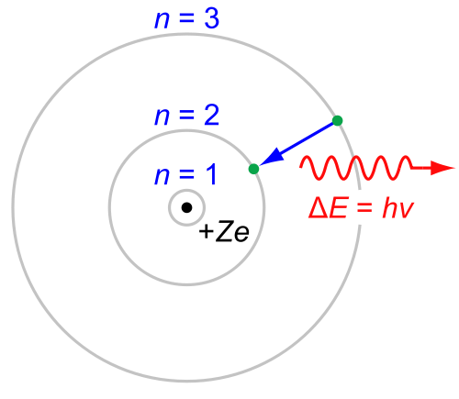
What is Quantum Mechanics? (Very Briefly)
Quantum = Packet of Energy
Electron
Atom
Photon
http://en.wikipedia.org/wiki/File:Bohr-atom-PAR.svg

Slide 6
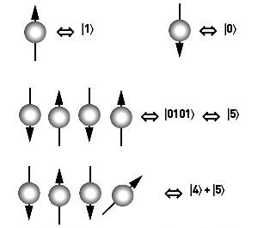
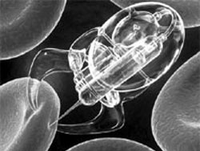
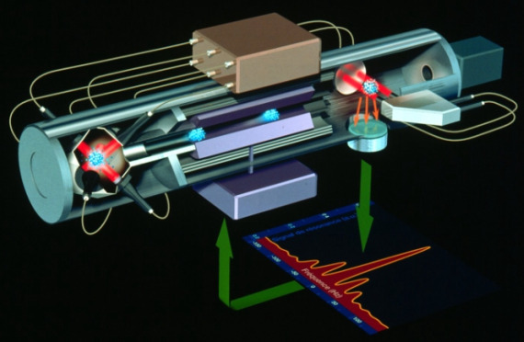
Practical Applications - Semidistant
Quantum Computing
  The more we know about QM, the faster it will happen.
Nanotechnology
  Quantum effects become important at small scales.
Atomic Clocks
  Strontium is the next candidate.
http://www.rose-hulman.edu/Class/ma/holden/Math475/
http://www.villainsource.com/doomsday.html
http://ablogtoread.com/watch-industry-news/pharao-to-be-most-accurate-atomic-clock-in-space/

Slide 7
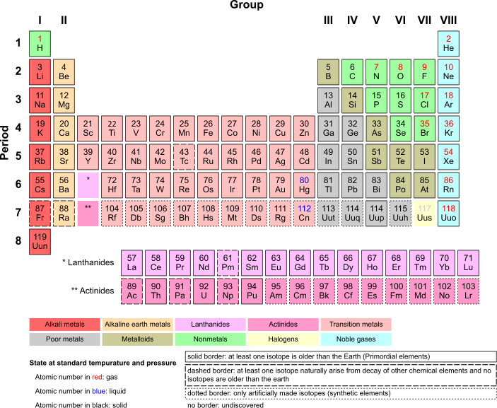
Specific Goals of Steck Lab
Build an apparatus capable of performing experiments with Strontium atoms.
  The Rb experiments are still running!
Study the Casimir-Polder force.

Slide 8
The Casimir Effect
Heisenberg Uncertainty Principle.
  Absolute measurement is impossible.
  Zero isn’t quite zero.
Vacuum Fluctuations exist even in “empty” EM fields.
  Background “White Noise”
  Can exist at any frequency.
  Can interact with matter.
Matter sets conditions on interacting VFs.
  Countable vs Uncountable Infinity
Drops off with inverse 5th (1/32)

Slide 9
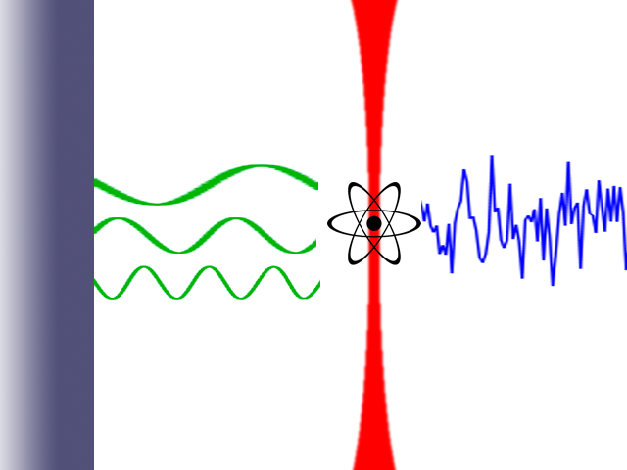
The Casimir Effect
Surface
Optical Lattice
Vacuum Fluctuations
All Frequencies Allowed
Standing Waves Only
Net Force

Slide 10

Surface
Strontium
Emission
Spectrum
Potential
Energy

Slide 11
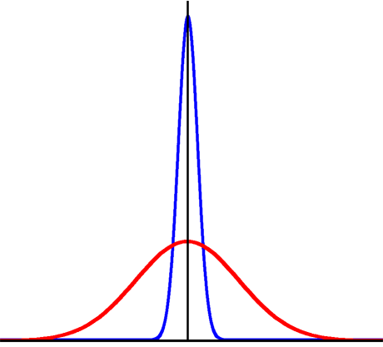
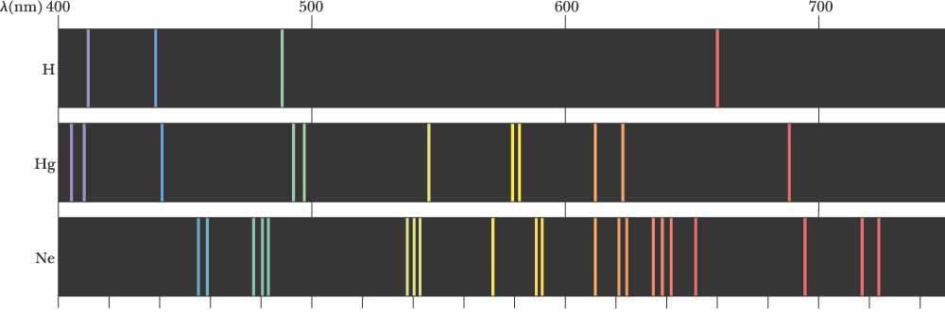
Why Strontium?
Strontium is difficult to work with, why bother?
  Low vapor pressure.
  Requires four different laser frequencies.
Has a thin emission line that can be used as a precision measurement tool.
http://www.cbu.edu/~jvarrian/252/emspex.html
Intensity
Frequency

Slide 12
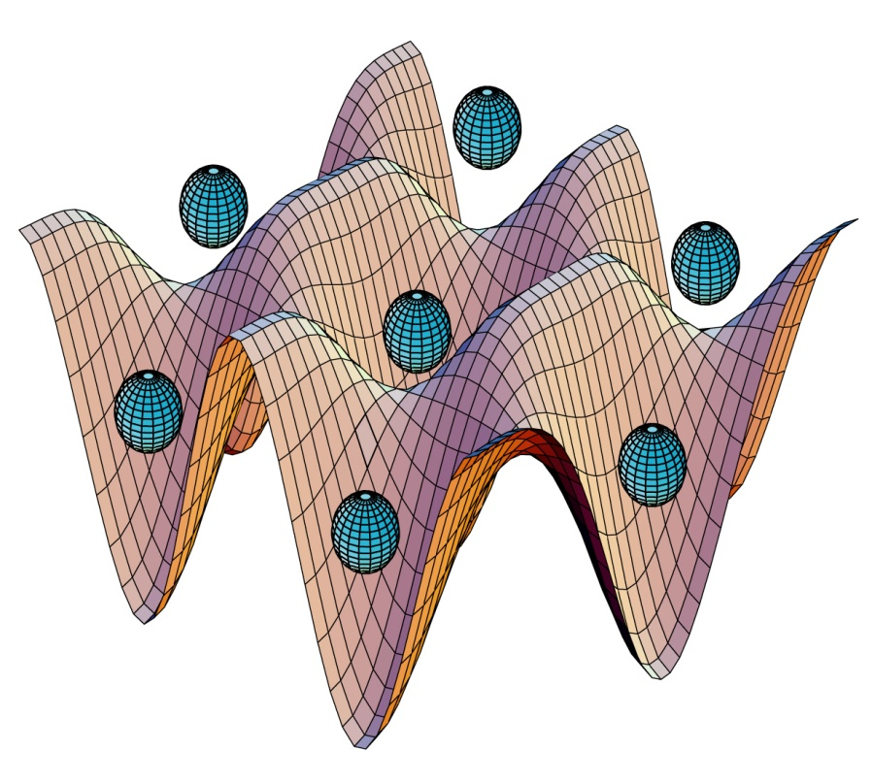
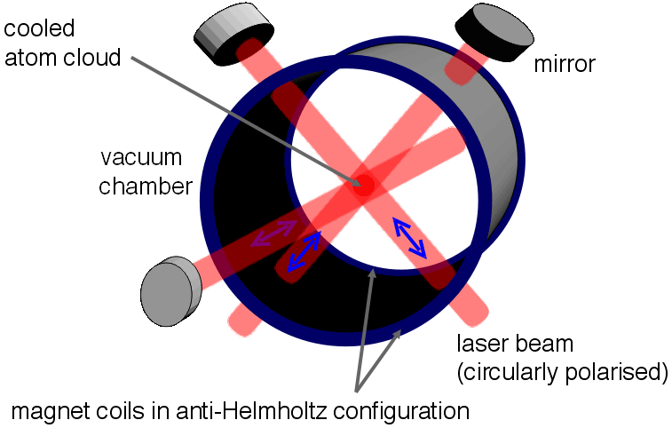
Atom Manipulation
Laser trapping
  Magneto-Optical Trap (MOT)
  Optical Lattice
Image Source: http://www.physics.umd.edu/rgroups/amo/rolstonwebsite/bec.htm
Image Source: http://en.wikipedia.org/wiki/Magneto-optical_trap

Slide 13
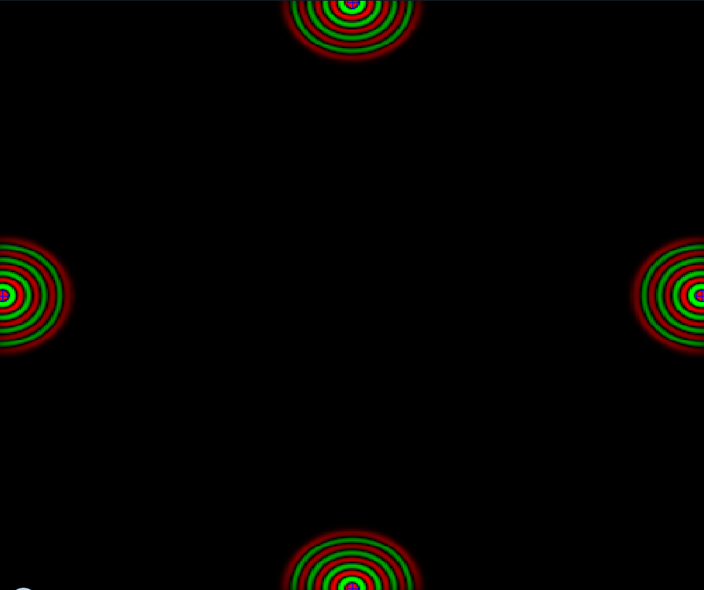
“Ripple Tank” by Paul Falstad http://www.falstad.com/ripple/

Slide 14
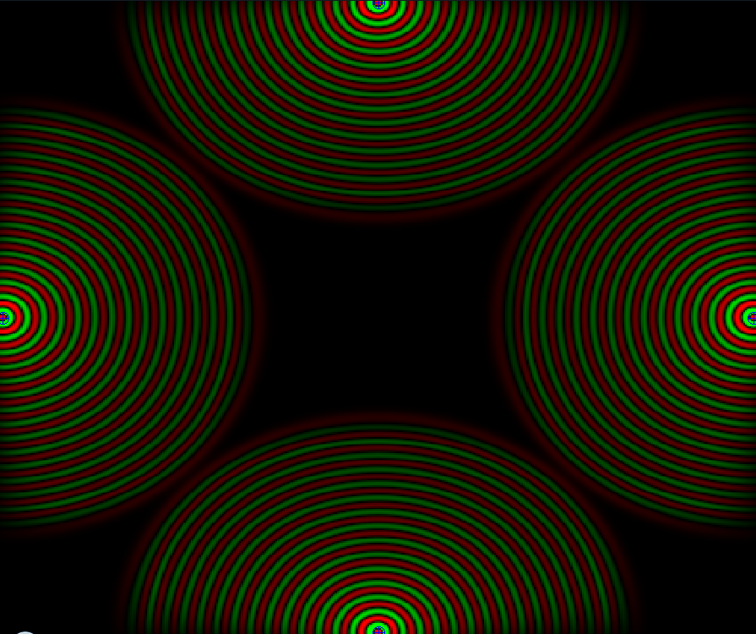
“Ripple Tank” by Paul Falstad http://www.falstad.com/ripple/

Slide 15
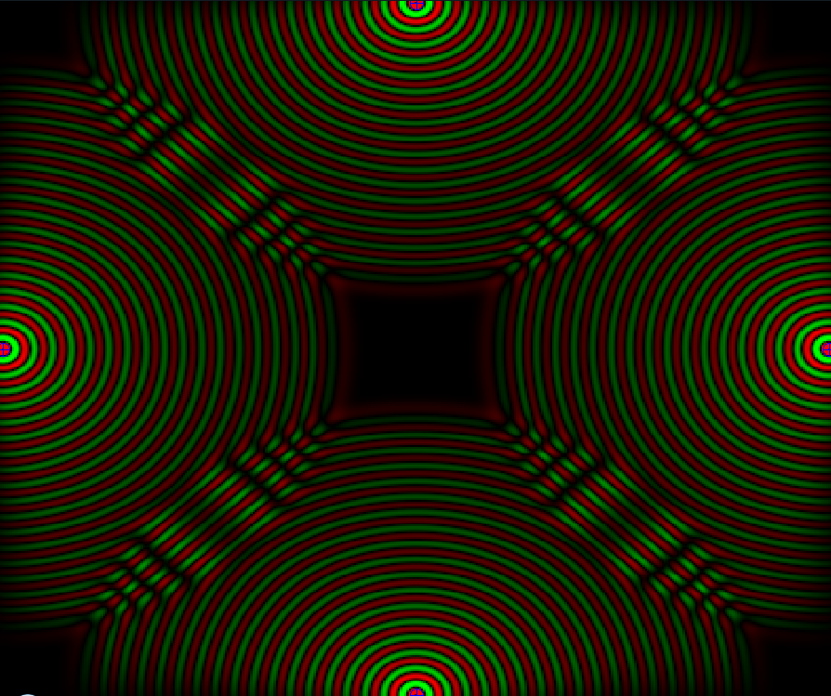
“Ripple Tank” by Paul Falstad http://www.falstad.com/ripple/

Slide 16
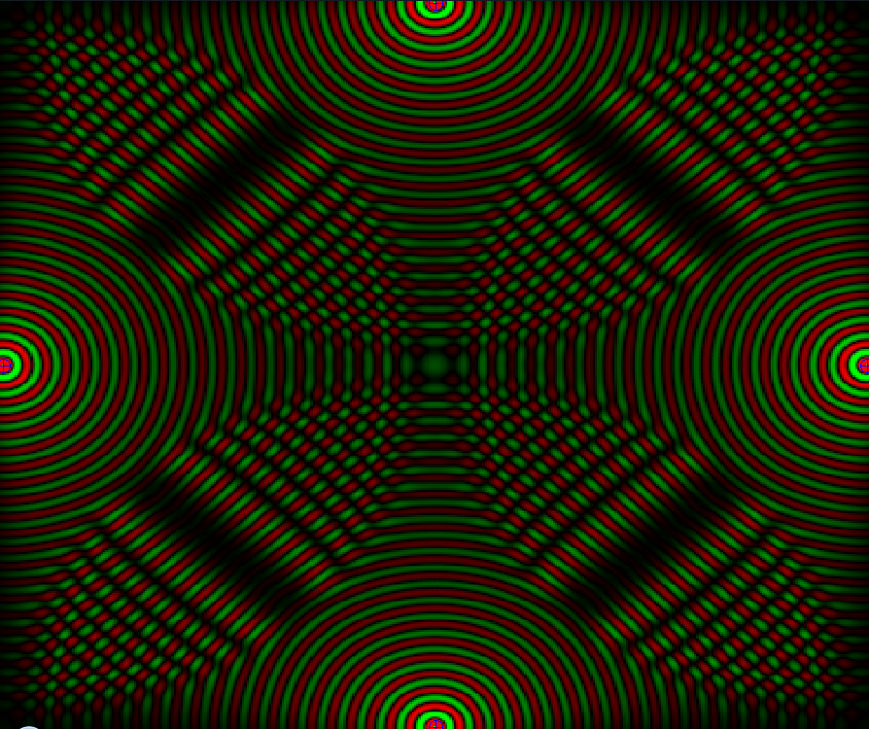
“Ripple Tank” by Paul Falstad http://www.falstad.com/ripple/

Slide 17
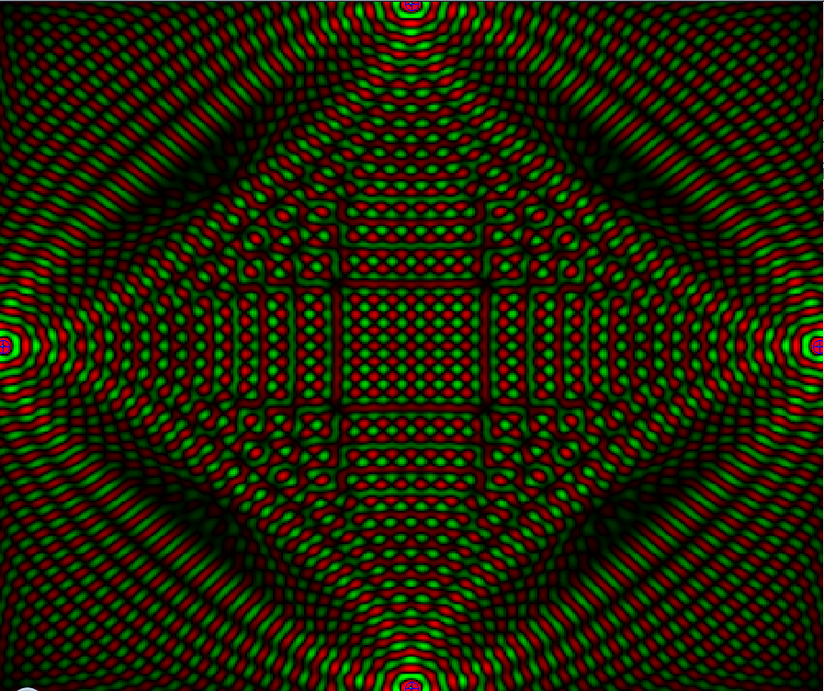

“Ripple Tank” by Paul Falstad http://www.falstad.com/ripple/
Optical Lattice

Slide 18
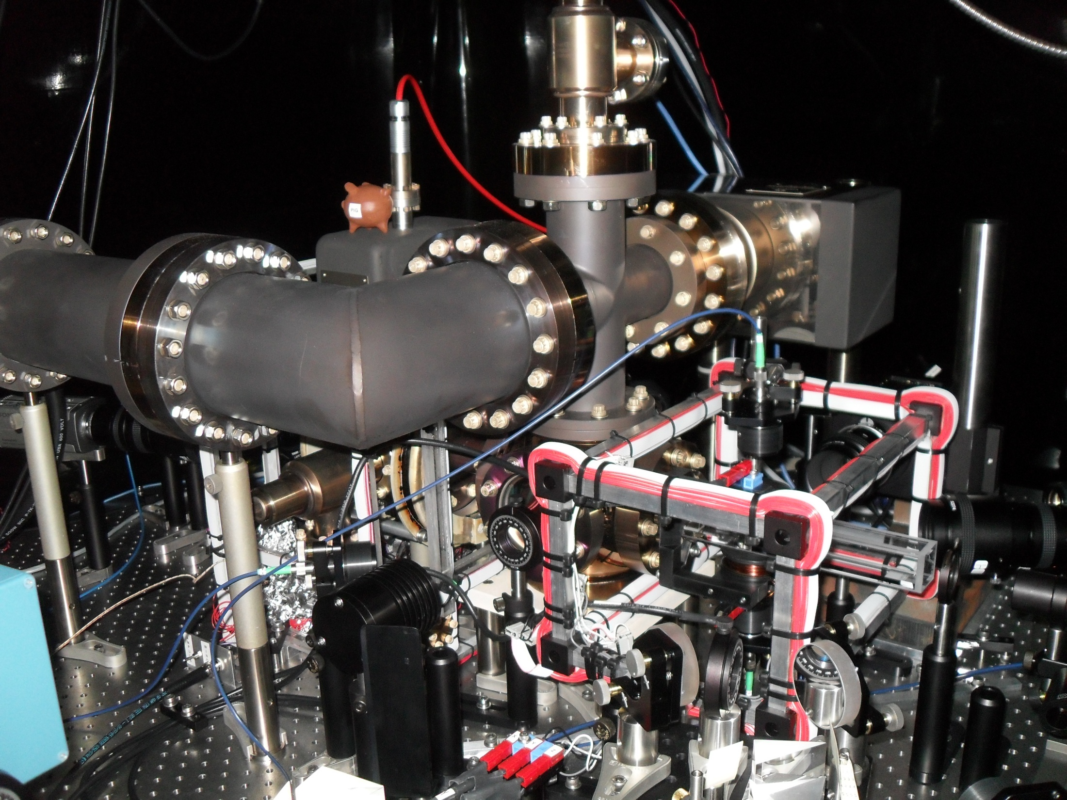

Slide 19
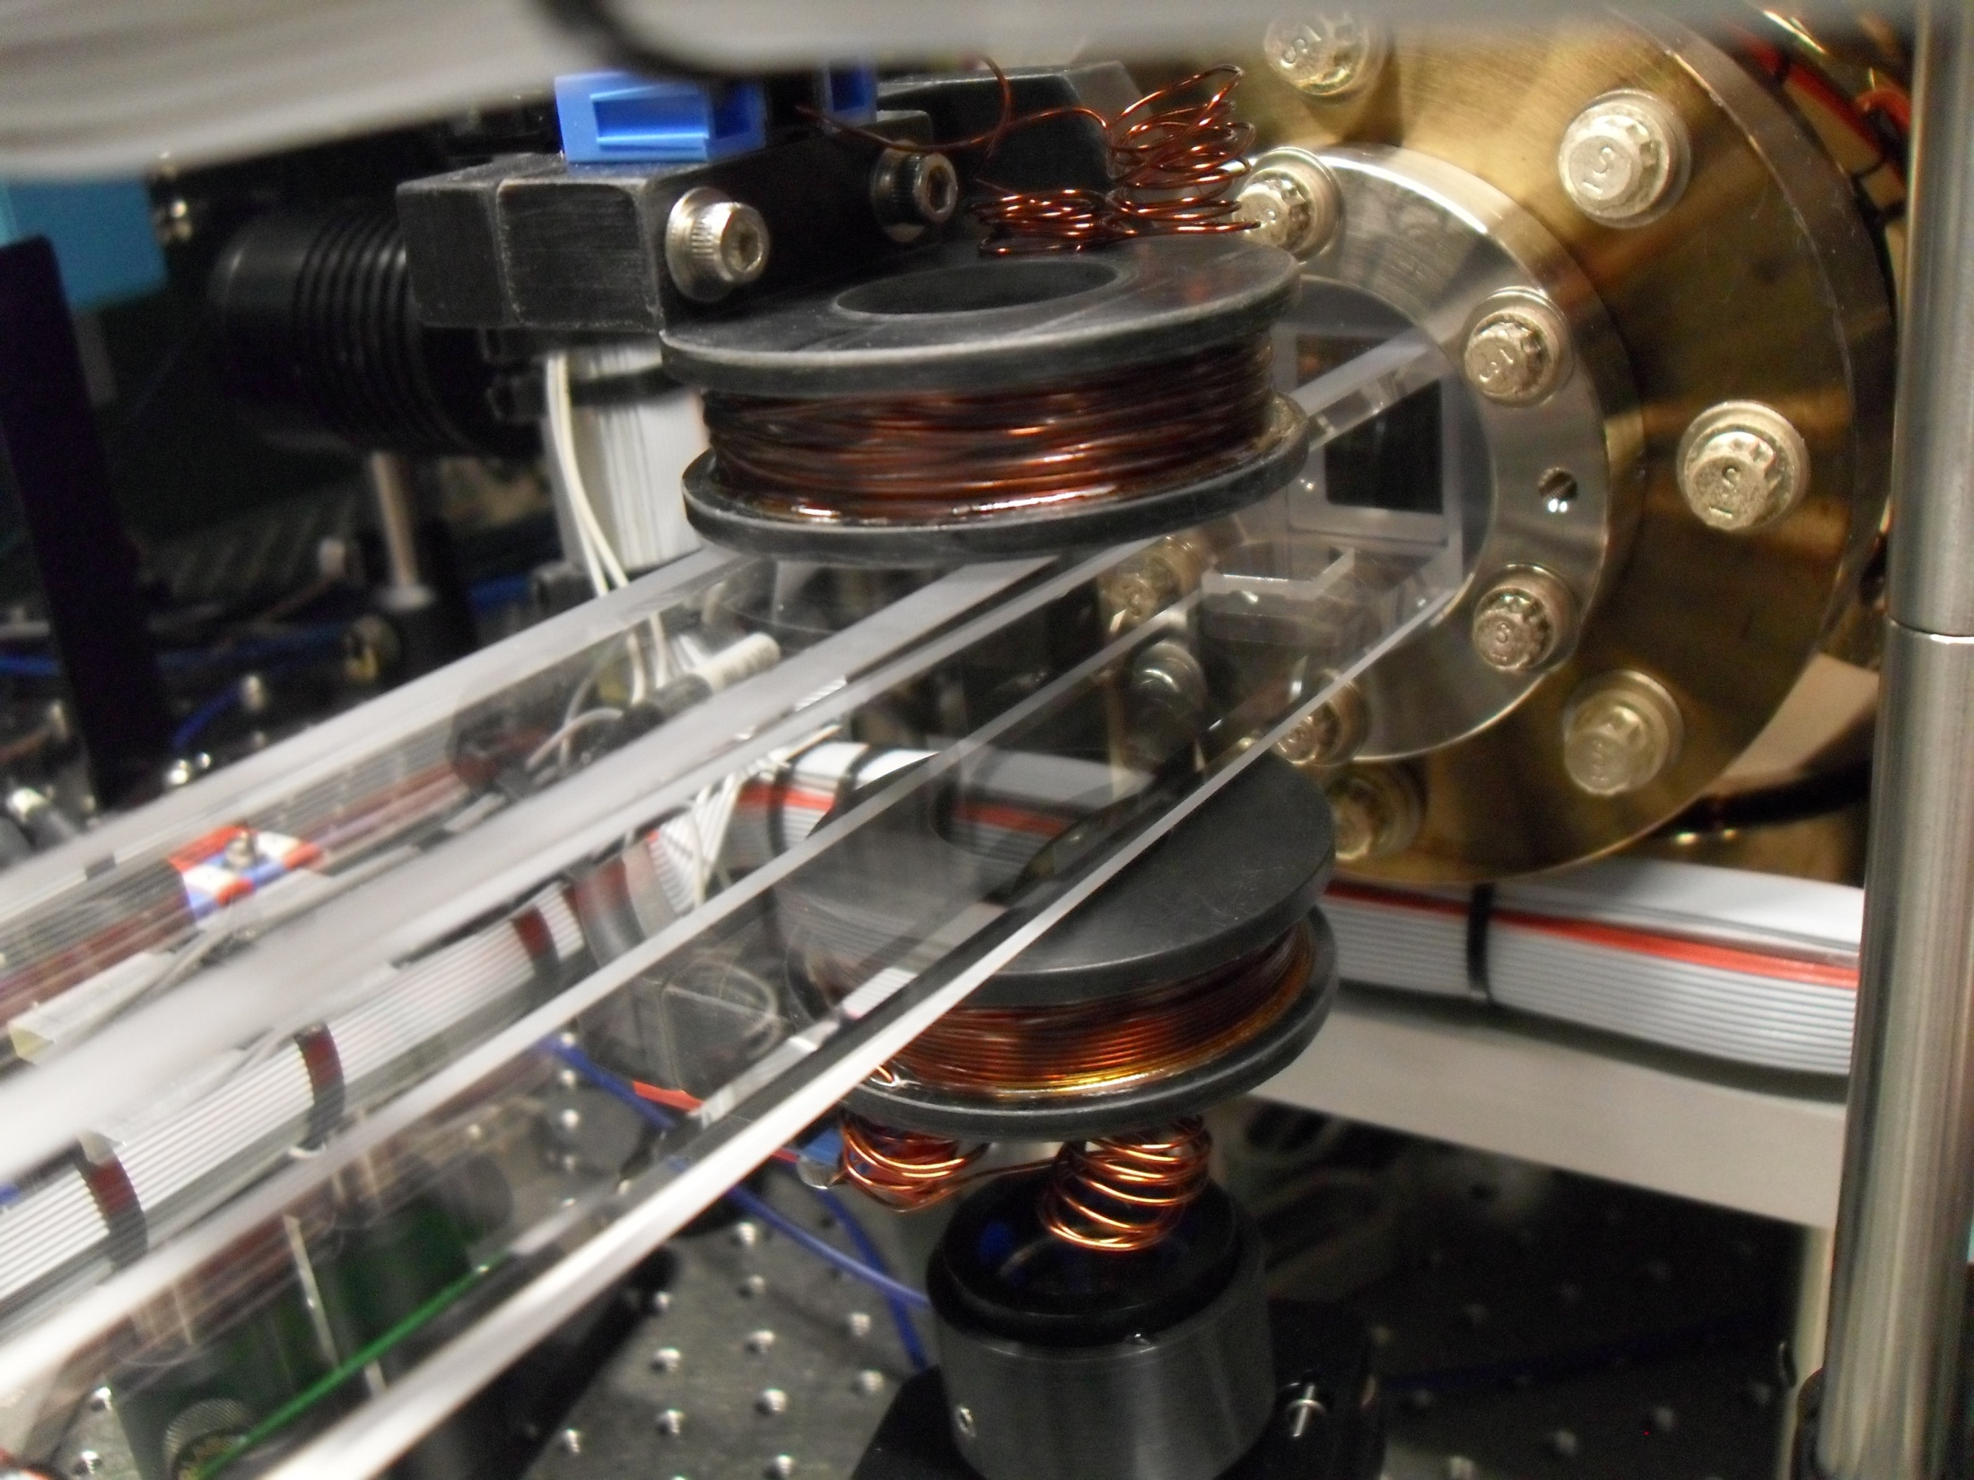

Slide 20
Diode Lasers
Small
Low Cost
Tunable
Sensitive to many factors.
  Difficult to maintain desired output.
  Require specialized equipment to stabilize.

Slide 21
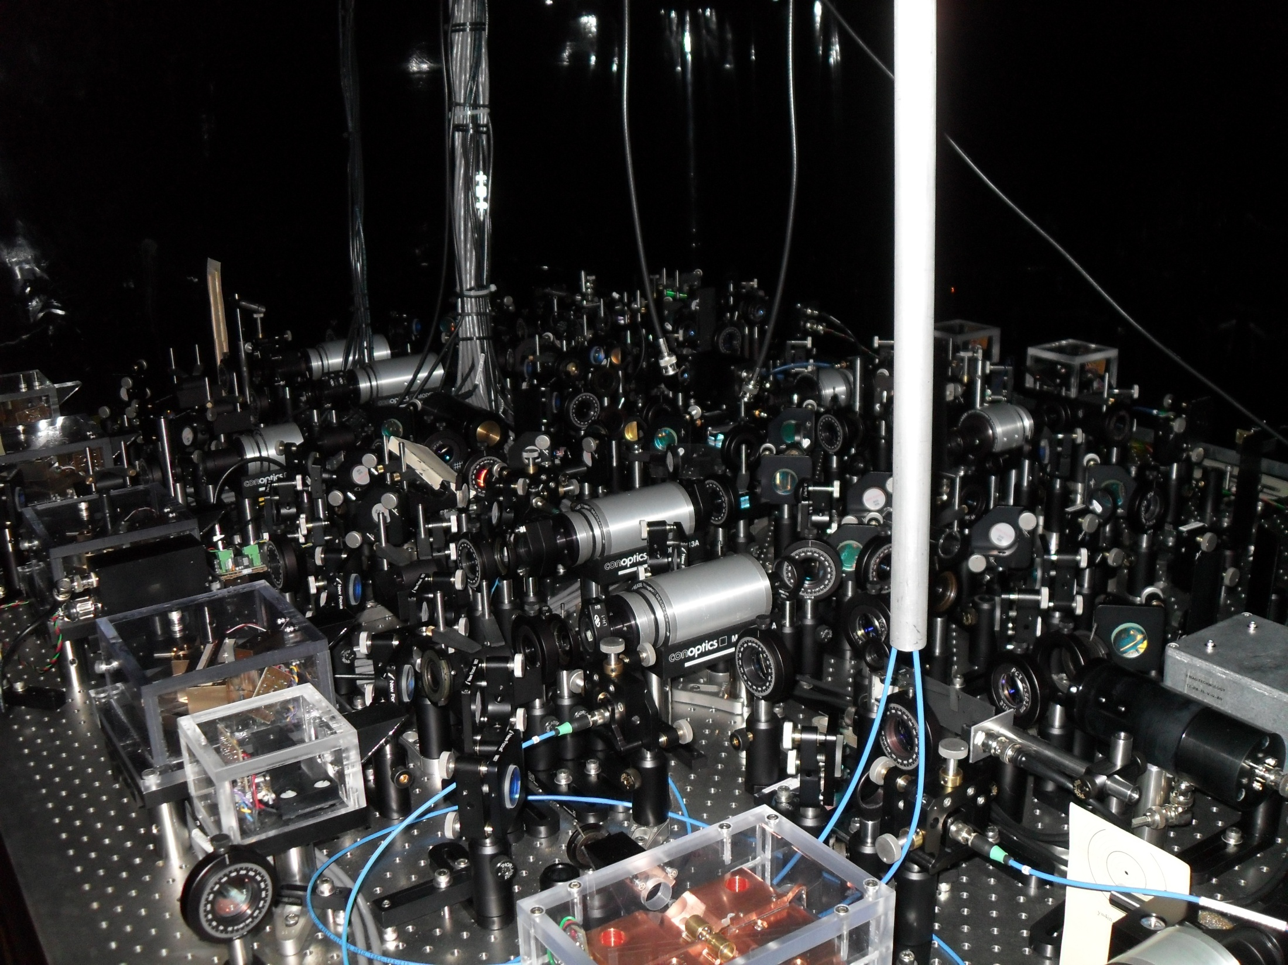

Slide 22
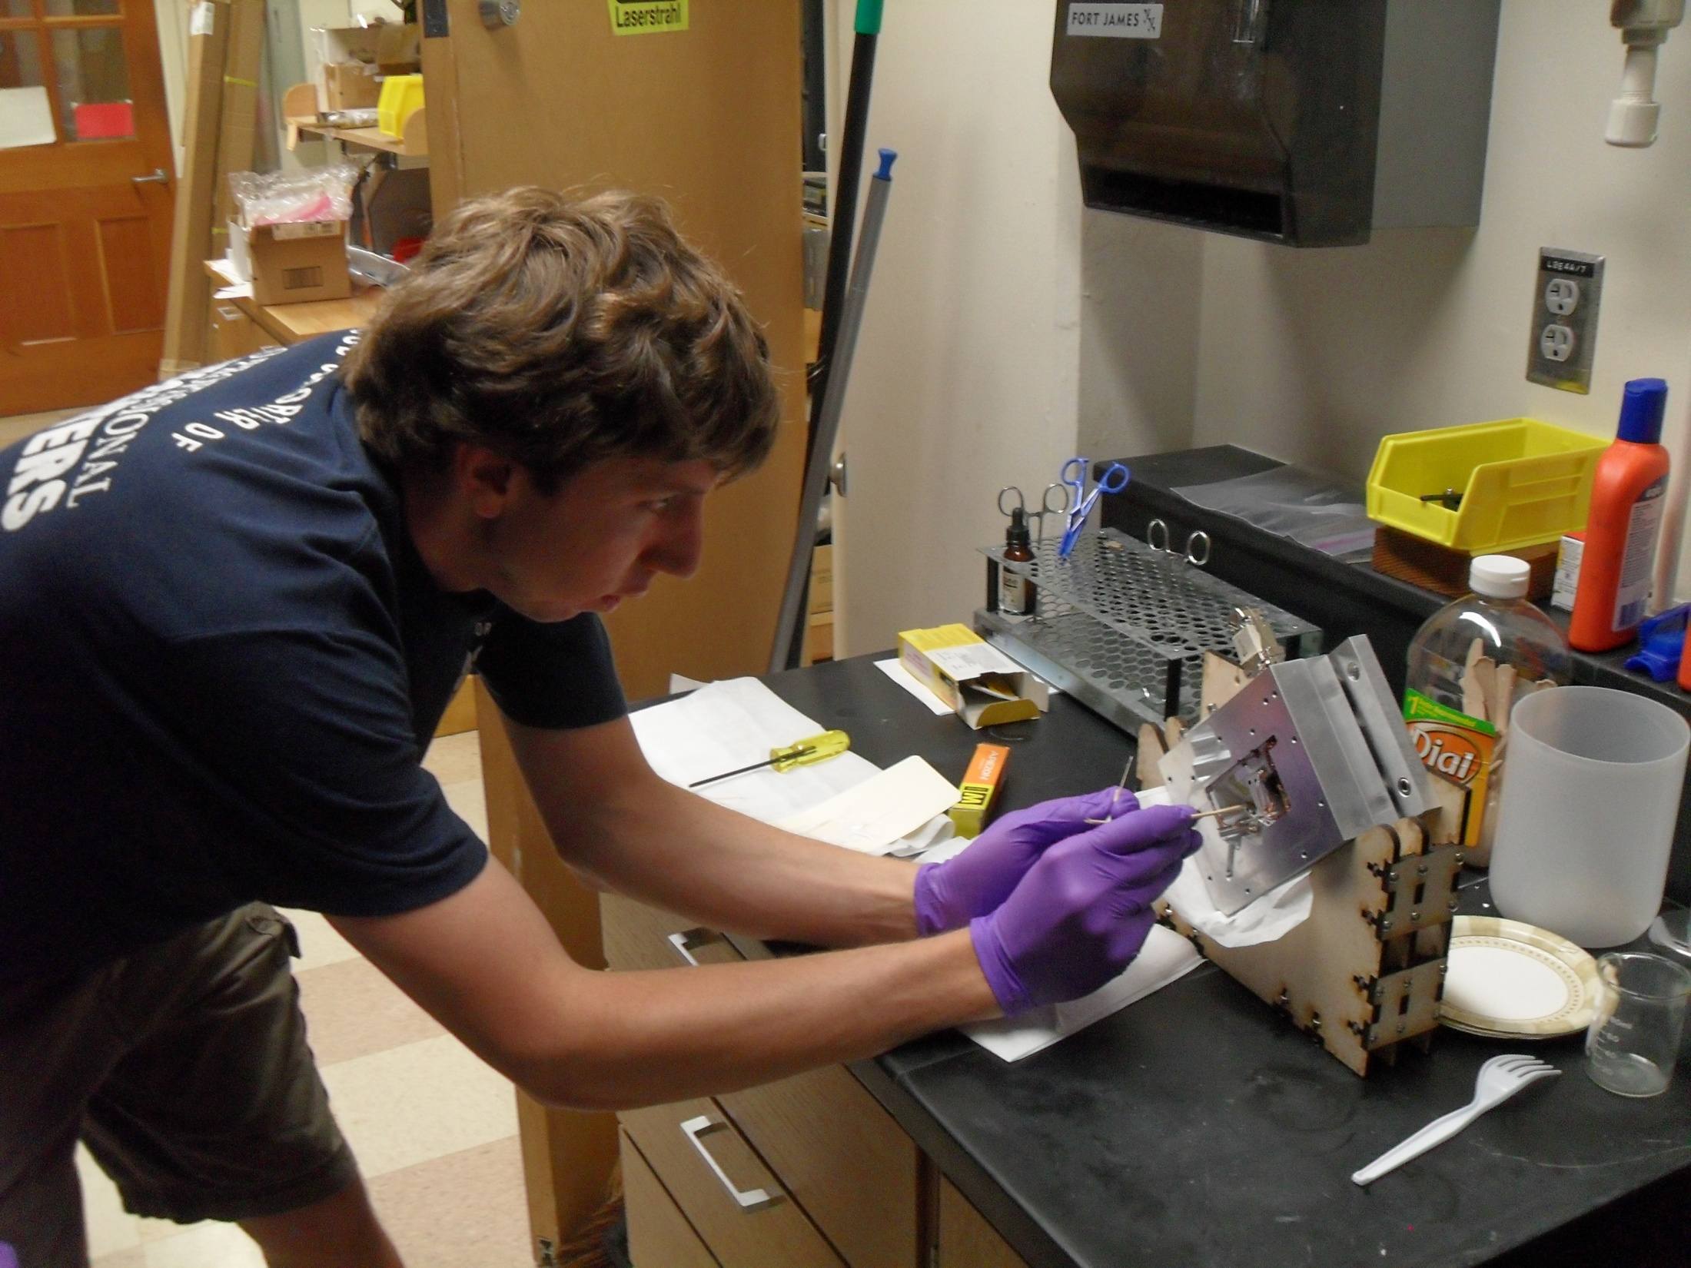

Slide 23
UCORE Fellow Contribution
Assemble a Master Laser Driver.
  Electrical Engineering 101
  Soldering…..
Calibrate and test equipment.
  “Paul…?”
Assemble a Fabry-Perot Cavity.
  Laser monitor.

Slide 24
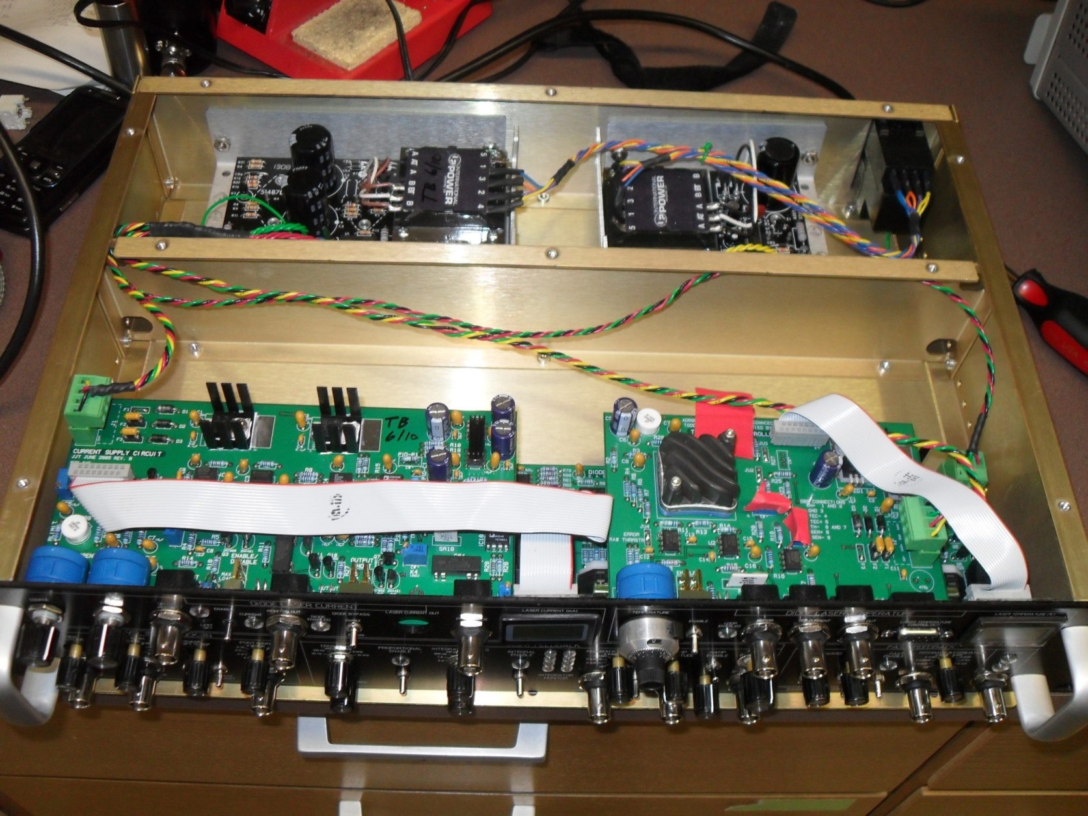
Master Laser Driver

Slide 25
Temperature Control
Prolongs life of laser diode.
Stabilizes frequency.
Allows precise adjustment of frequency.
  Heat is energy
  Energy of diode is related to the energy of its output.

Slide 26
Current Supply
Laser diodes are extremely sensitive to
  Current Draw
  Applied Voltage
Allows for modulation to correct frequency.
  Signal supplied by Lockbox.
Notes:
sdfgsdgfasdgsdg

Slide 27
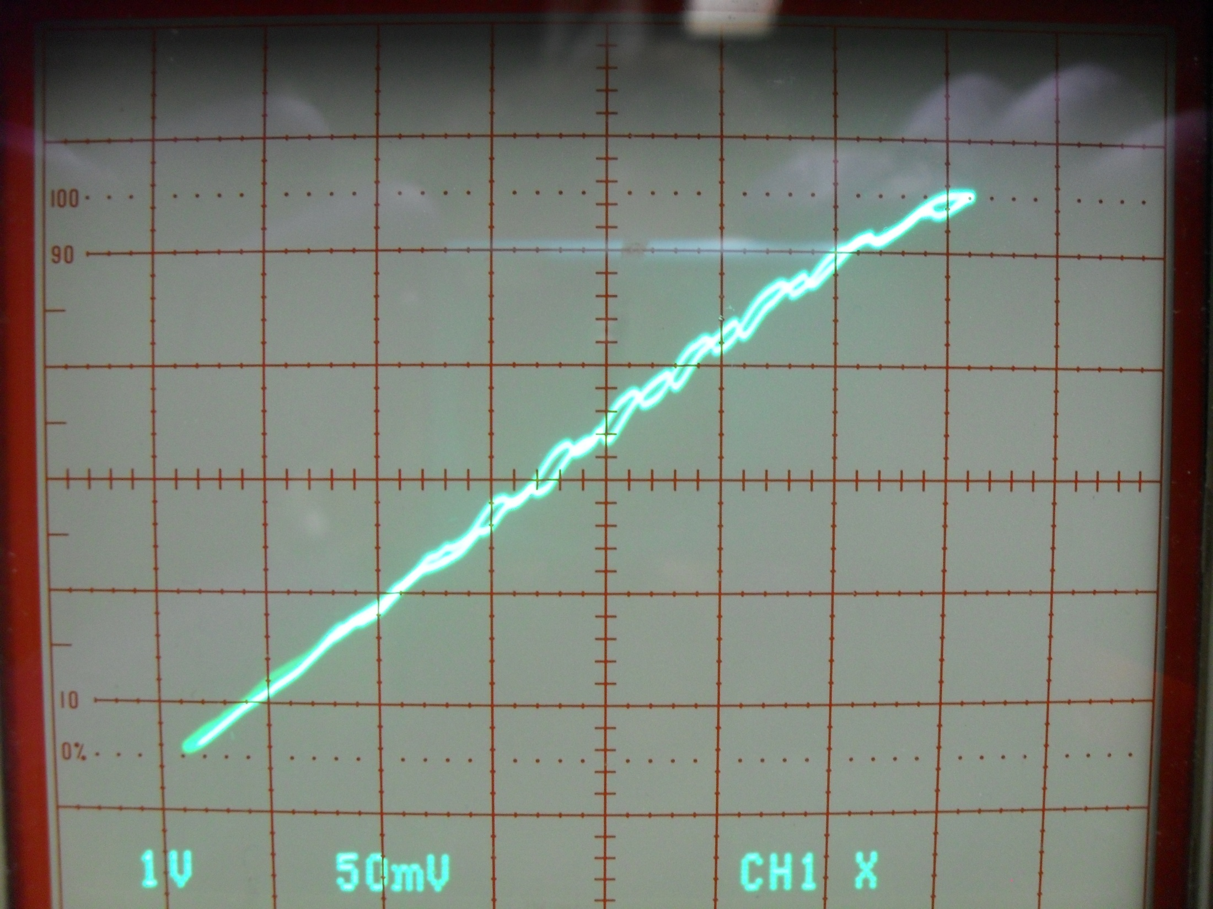
Laser Power Output
Applied Voltage

Slide 28
Frequency Lock-Box
Laser diodes are sensitive to
  Vibrations
  Aging
  Other uncontrollable events
Laser detection equipment feeds to Lockbox.
Lockbox generates an error signal.
Error signal modulates Current Supply and others.

Slide 29
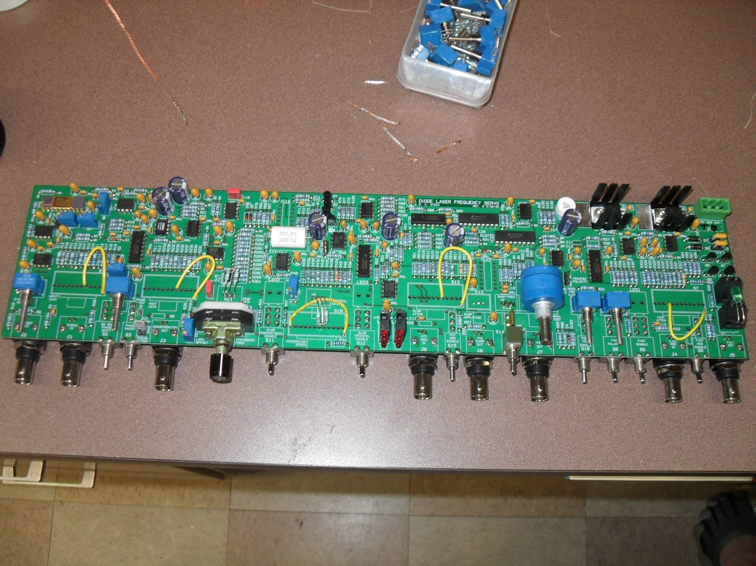
LOCKBOX PIC HERE

Slide 30
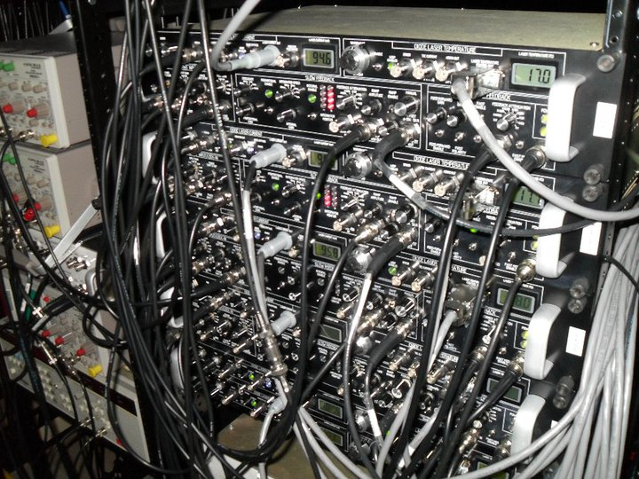

Slide 31
Fabry-Perot Cavity
Laser should operate on a narrow frequency range.
  But even with all this control…
Laser can operate on multiple frequencies.
  Multimode Lasing
  Useless for precision experiments.
FPC identifies bad output.

Slide 32
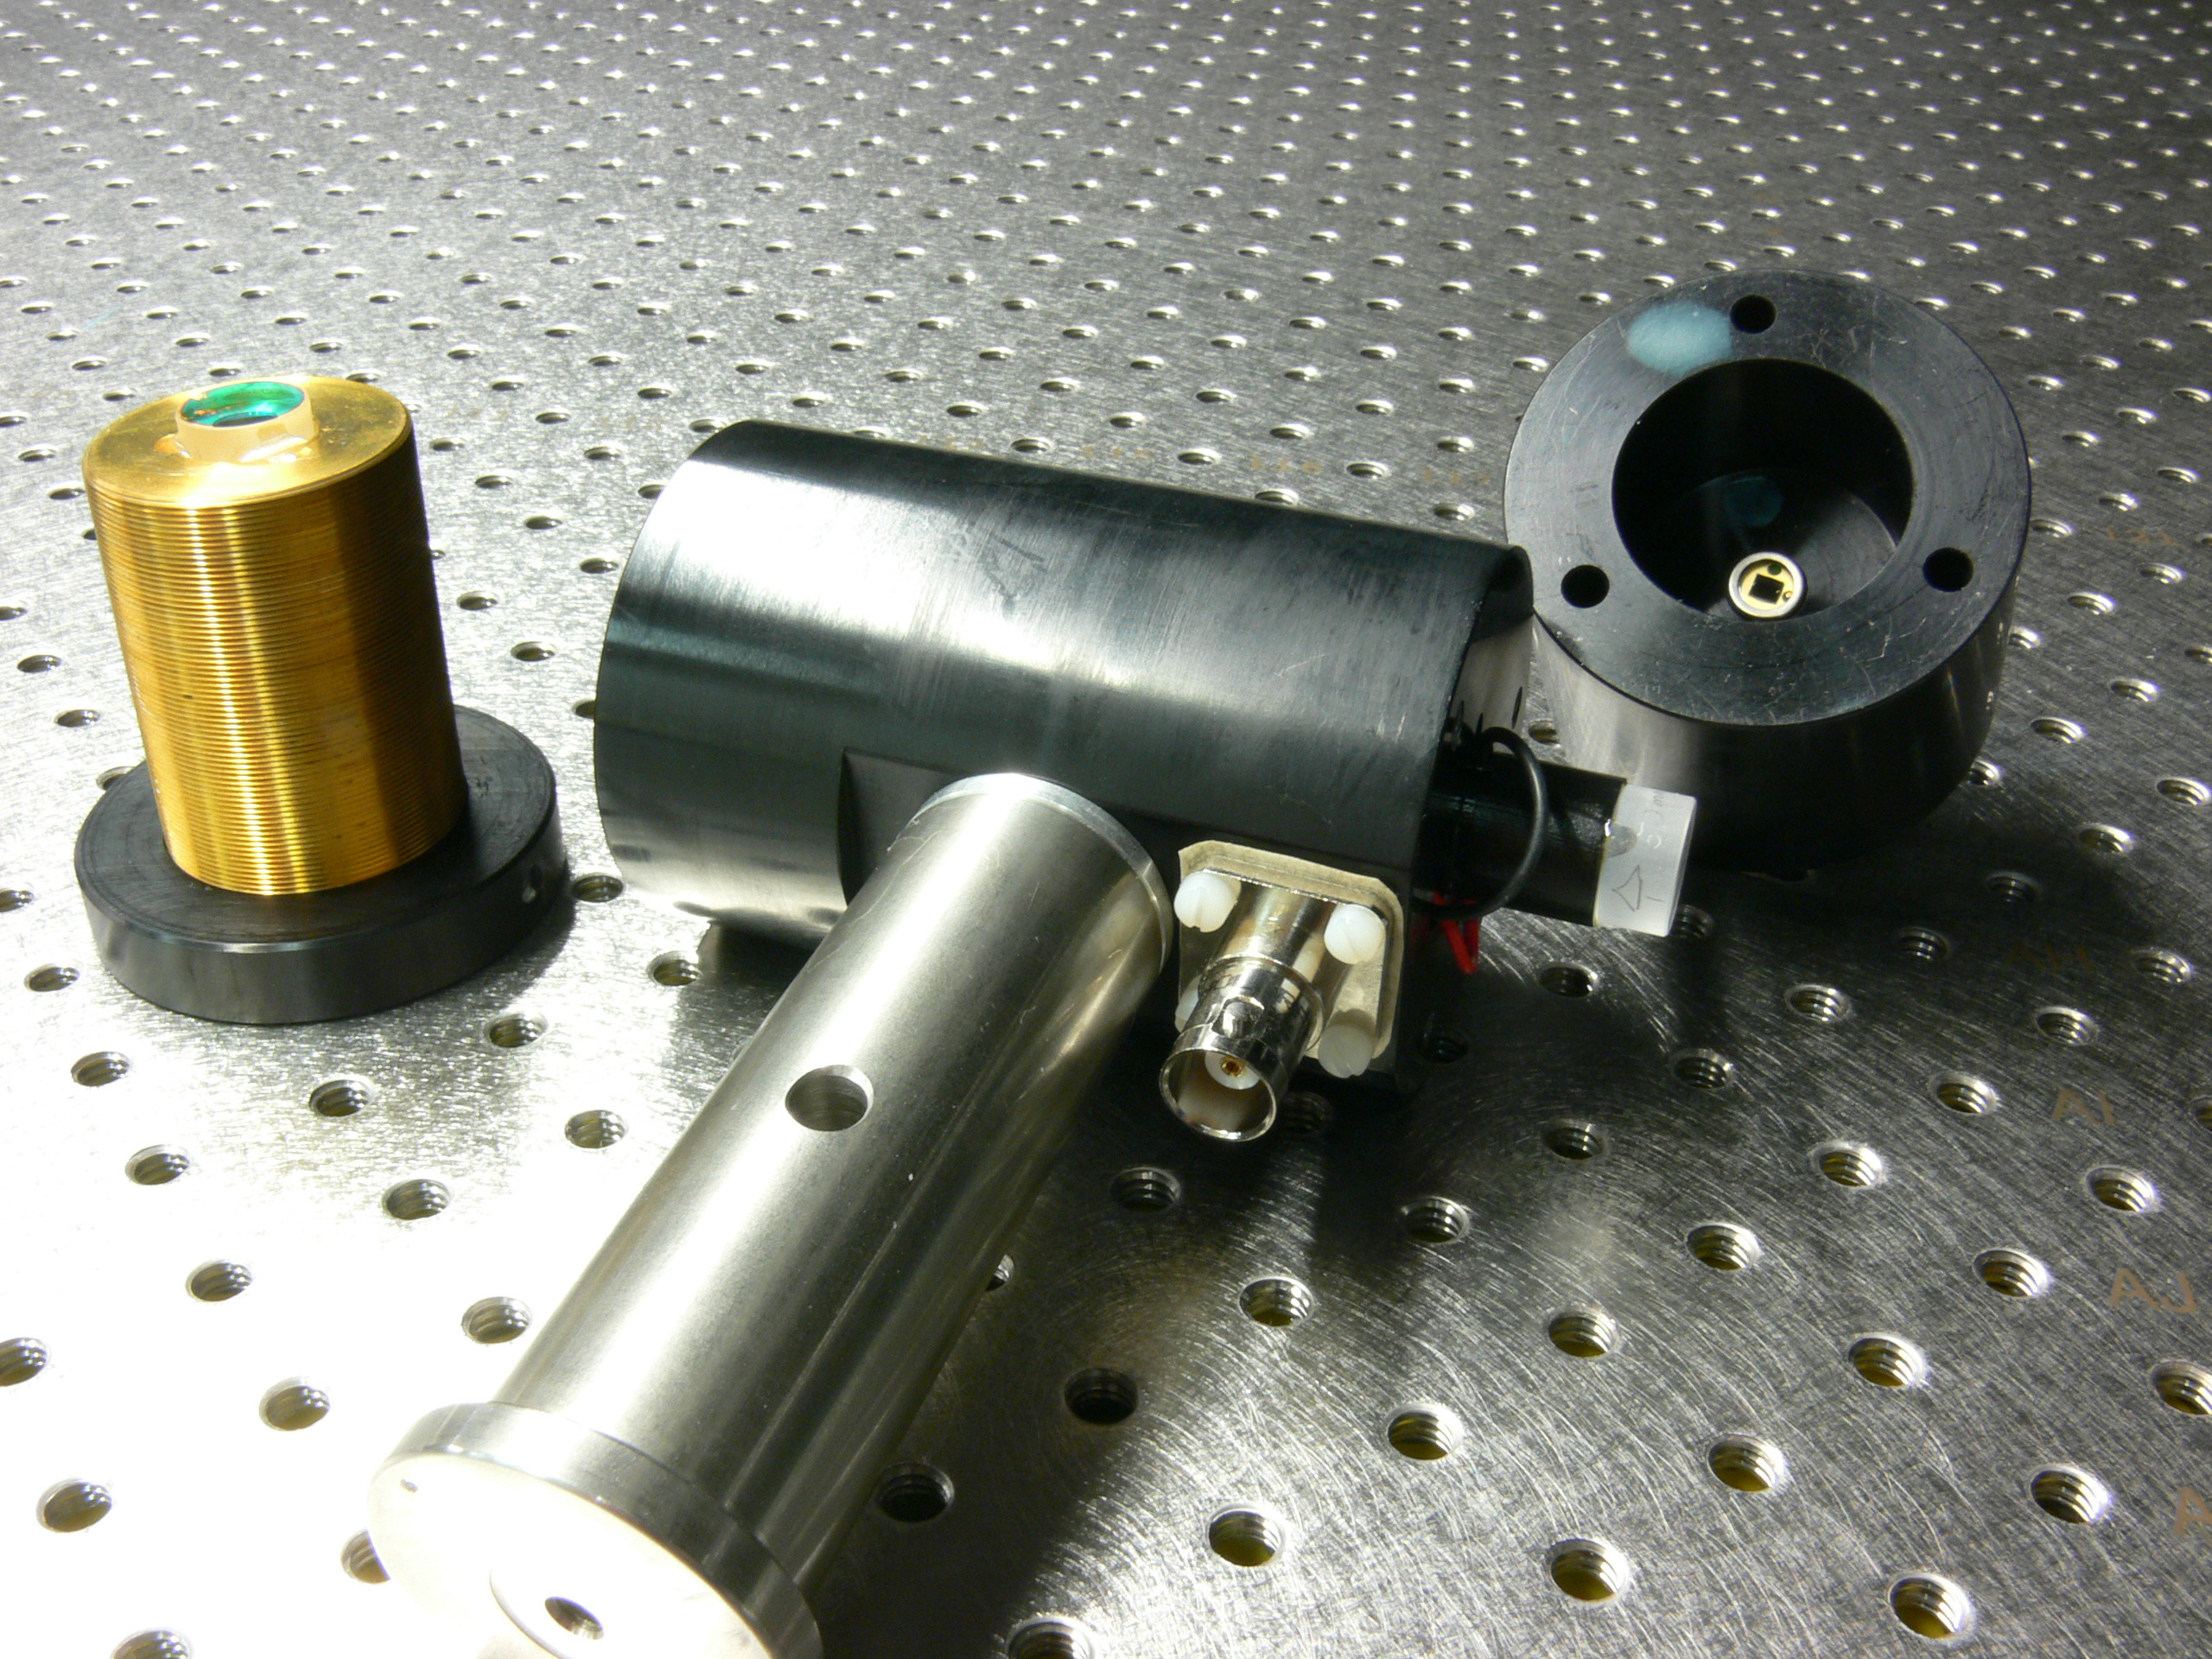
Photodiode
Mirror
Mirror
Actuator

Slide 33
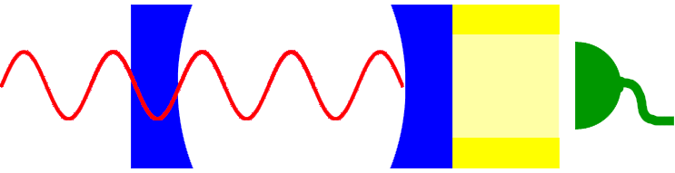
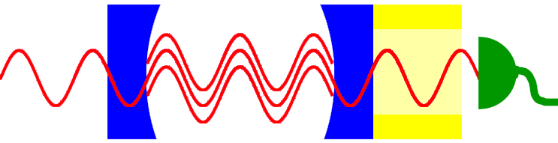
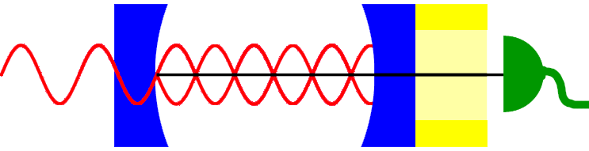
Fabry-Perot Cavity
λ
Laser Beam
Output to Oscilloscope
d=nλ/2
Constructive Interference
Voltage Registered
Waves Add to Zero
Destructive Interference
d=nλ/2
No Voltage Registered

Slide 34
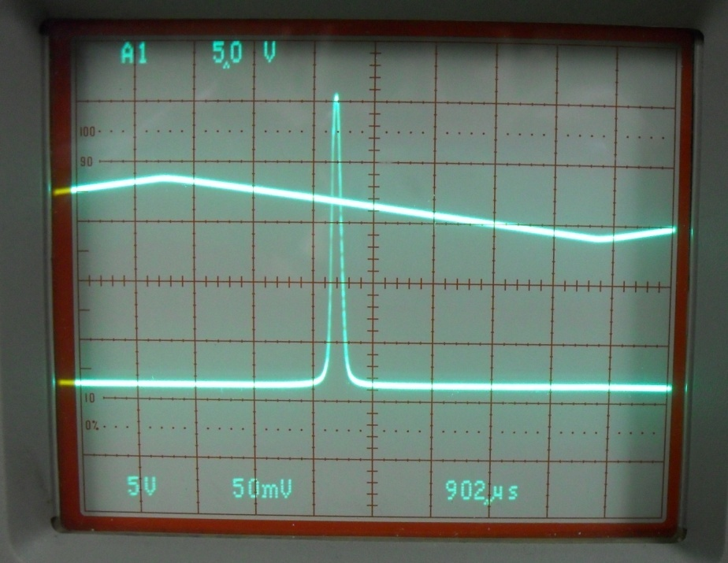
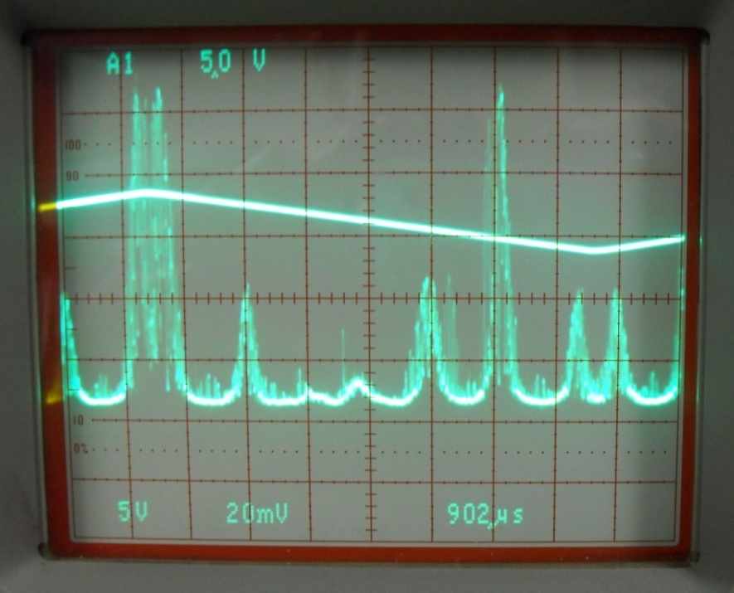
Fabry-Perot Cavity Output
Properly tuned laser output.
One narrow, precise frequency range.
Multimode Lasing
Useless for precision experiments.

Slide 35
Ultimate Goal of the Lab
Improve atom optics methods and technology.
Precisely measure the Casimir Polder Force
  It drops off with about the inverse 5th of distance.
  Better accuracy will make for better predictions later.
  This is fundamental physics research.
Related topics not studied by the lab directly:
  Gecko Tape
  Wormholes

Slide 36
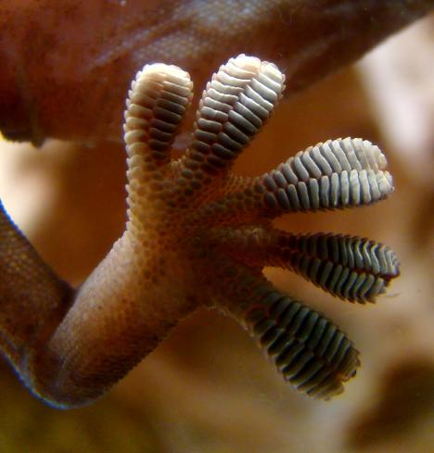
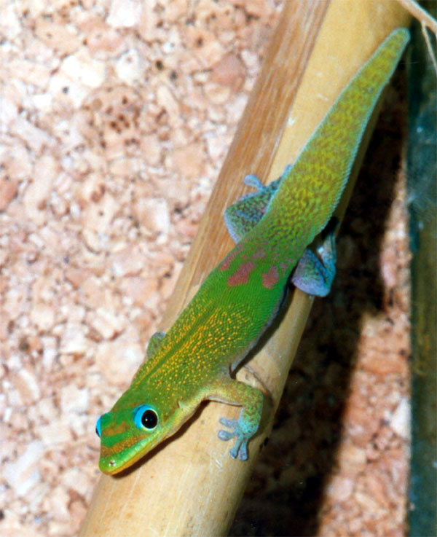
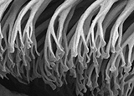
Geckos and the Casimir Effect
http://en.wikipedia.org/wiki/Gecko
http://legacy.lclark.edu/dept/chron/stickybizsm08.html

Slide 37
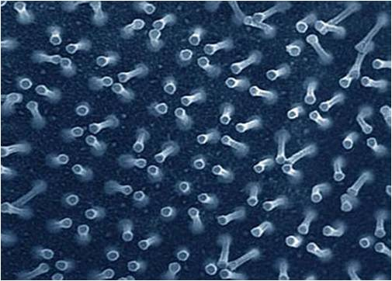
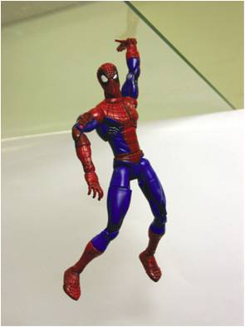
Gecko Tape in Development
Notes:
http://upload.wikimedia.org/wikipedia/en/a/a5/Test_of_gecko_tape.jpg

Slide 38
Wormholes
Space-time is warped by mass and energy within it.
Normally, only mass and positive energy have a large scale effect on space-time.
The Casimir Effect produces an area of negative energy due to it’s utilization of vacuum energy.
Physicists including Stephen Hawking have theorized that negatively curved space-time is required for the realization of a large scale wormhole.

Slide 39
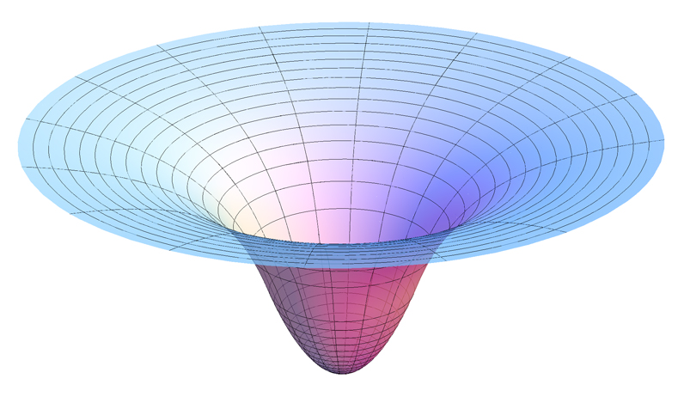
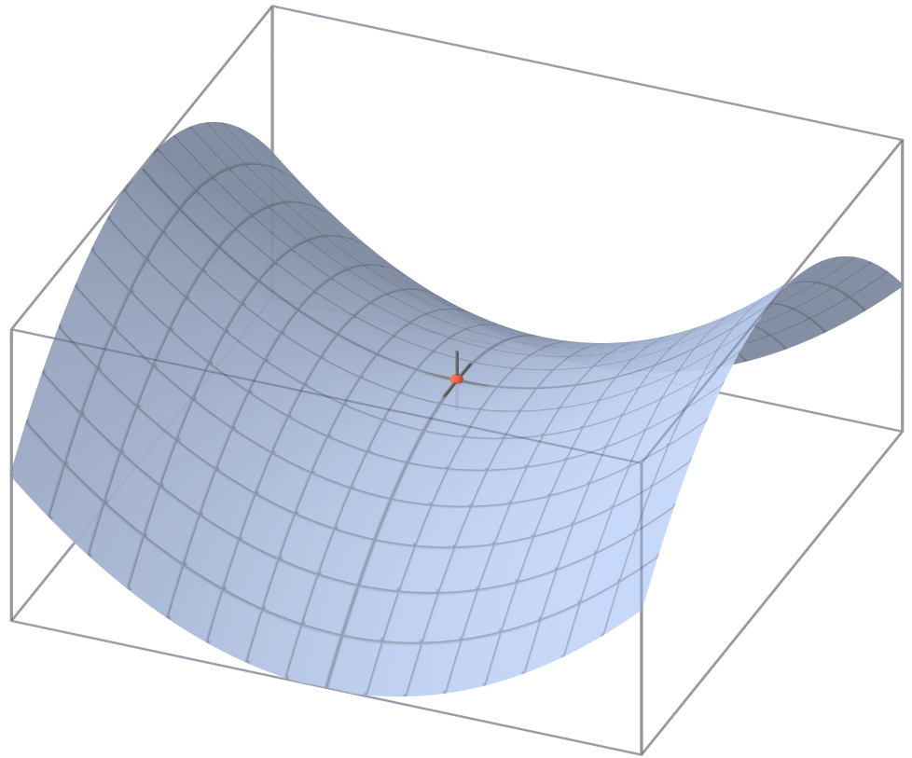
Curved Space-Time
Negative Curvature
Positive Curvature

Slide 40
Acknowledgements
Steck Lab
  Paul Martin
  Eryn Cook
  Libby Schoene
  Jeremy Thorn
  Daniel Steck
UCORE Staff
  Tim Sweeney
  Kate Hulpke
  Dean Livelybrooks
UCORE Fellows
  Special thanks to
    Leslie Bicknell
    Jesse Klinger
Lane Community College
  Dennis Gilbert
  Gary Mort
  Jean Cassidy
The National Science Foundation

Slide 41
Questions?
Big Picture
  Science is good.
  Distant future applications.
    Quantum Computing, Nanotechnology, Atomic Clocks, Geckos
Lab Focus
  Develop experimentation for Strontium atoms.
  Measure the Casimir-Polder Force.
  Diode Lasers
UCORE Fellow Contribution
  Master Laser Driver
    Temperature, Current, Frequency Lockbox
  Fabry-Perot Cavity

